Slide 1
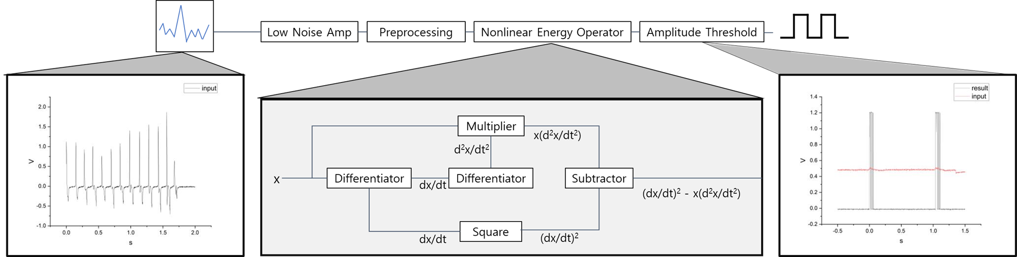
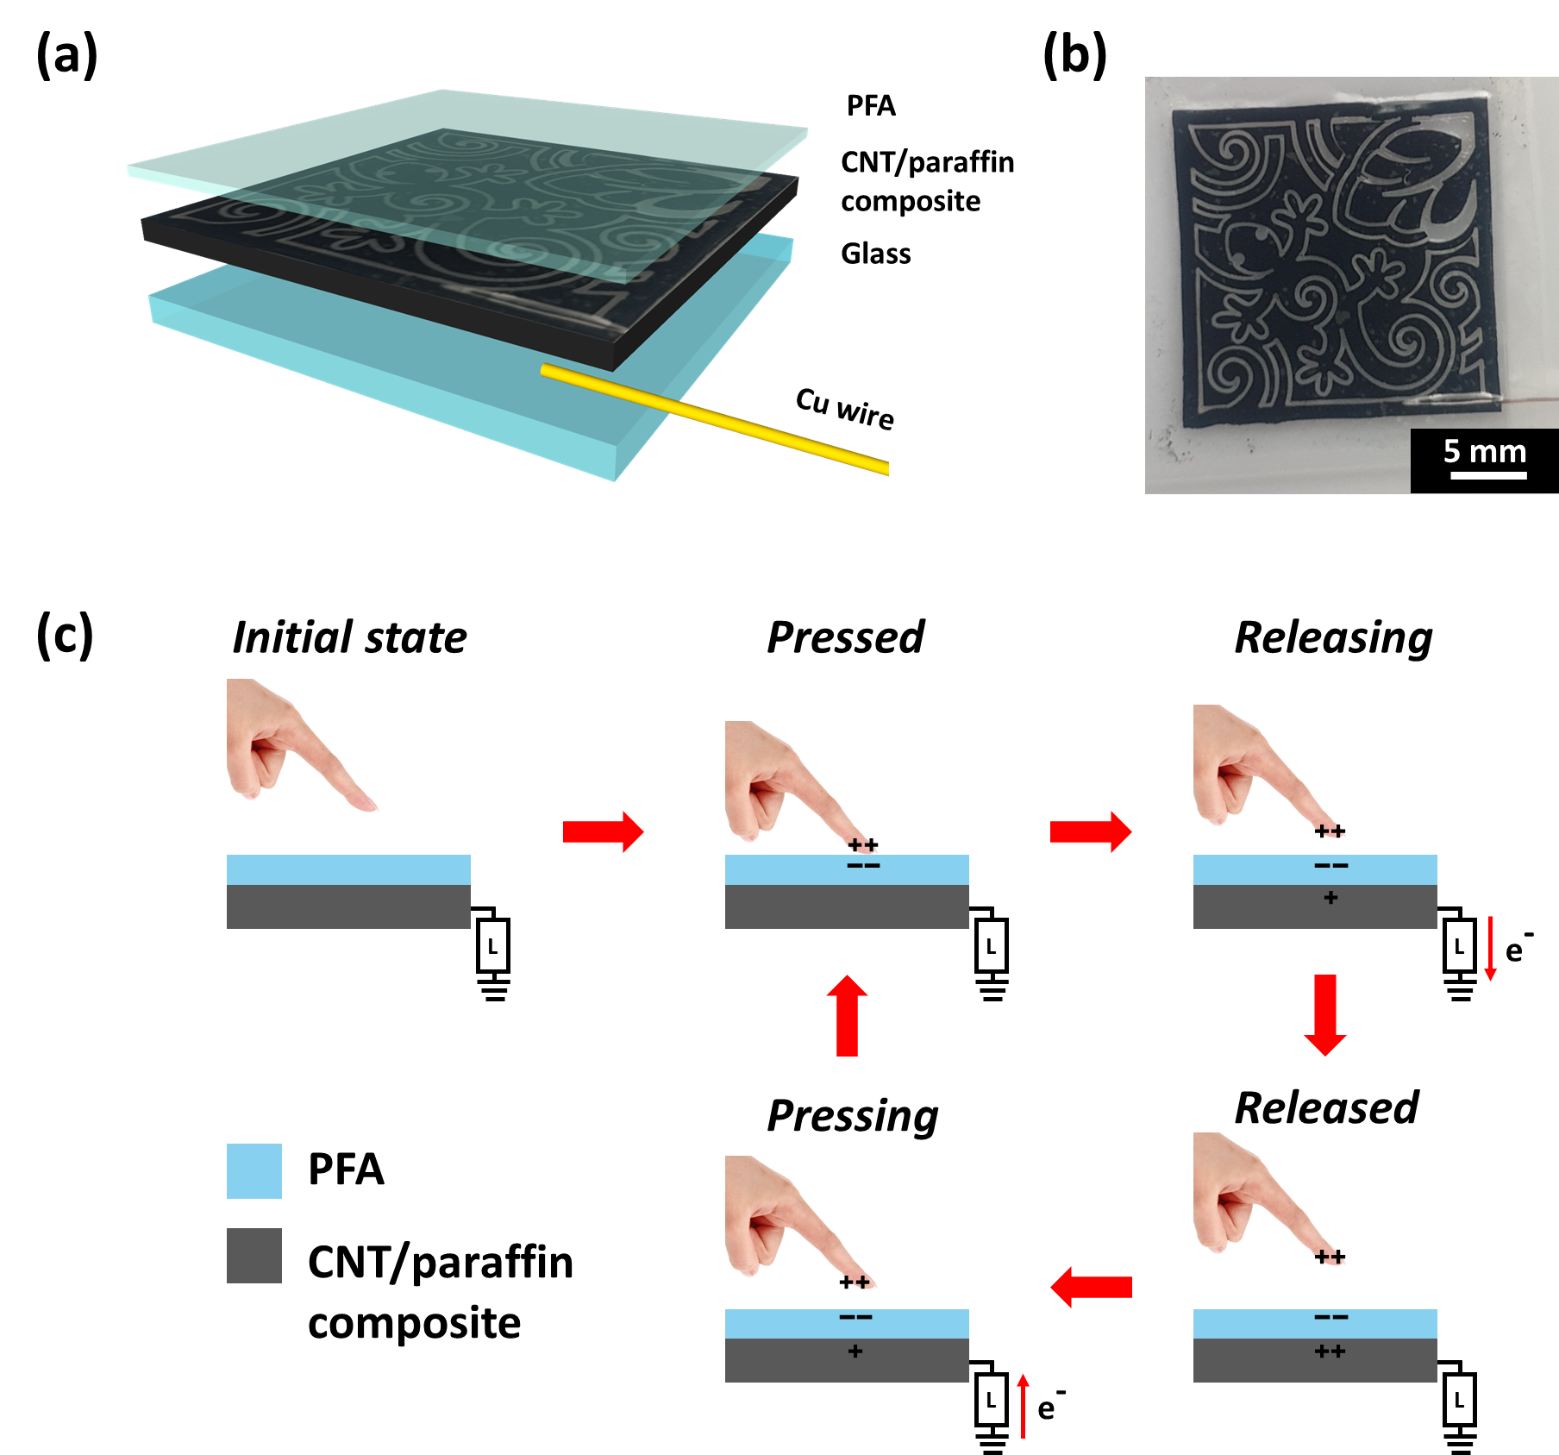
Design of Low-power Touch Sensor System for Detecting the Signal of Triboelectric Nanogenerator
Joonyoung Lim^{1, †}, Seokwon Joo^{1, †}, Chieun Choi¹, Chae-Eun Lee¹, Yuri Kim¹, and Yoon-Kyu Song^{1,} *
¹ Graduate School of Convergence Science and Technology, Seoul National University, Seoul 08826, Korea
E-mail: ¹limjoony@snu.ac.kr
Methods
Abstract—The basic working principle for contact-electrification enabled nanogenerators, i.e. triboelectric nanogenerators (TENGs) is a combination of contact electrification and electrostatic induction. As its output pulses are in shape of a spike, we utilized ultra-low power spike recording system for a touch sensor. For low-power system configuration, a low-power analog amplifier operating at 1.2V was used to record the signal generated by the TENG device, and an effective sensor configuration was achieved by introducing a spike detecting method using an operator.
The fabrication of a CNT/paraffin composite-based single-mode TENG touch sensor was followed by the methods in our previous report [1].
Non-linear energy operator of the input signal is implemented through analog calculation.
Since it uses frequency for calculation as well as amplitude and additionally considers the short instantaneous frequency change of the spike, it has a robust property against low frequency and high amplitude noise as an advantage.
RESULTS
Figure 1. Block diagram of spike detection circuit. Non-linear Energy Operator (NEO) can be expressed in the form (y')²-y×y'' in the y = f(t) time function. In the case of triboelectric power produced by TENG, the peak duration is short, so the spike-type output represented by the peak was applied to a sensor system using a spike detection algorithm and used for signal measurement.
(a) (b)
Figure 2. (a) Structure of the patterned CNT composite based TENG device. (b) Optical image of the TENG device. (c) Mechanism of the TENG touch sensor.
Figure 3. The open-circuit voltage of the TENG device according to the various touch pressure measured by a) oscilloscope and b) system.
conclusion
Here, we present a system detecting electrostatic like spike-type signal (i.e., very short peak duration and high voltage). Our system applies operator utilizing algorithm to detect a spike and used for signal measurement as detecting the TENG signal with various touching pressure via compact size chip (~1 mm²). These results are expected to be applied to wearable sensors and artificial skin using TENG devices.
The chip fabrication and EDA tool were supported by the IC Design Education Center(IDEC), Korea.
[1] Joo, Seokwon, et al. "Intaglio Contact Printing of Versatile Carbon Nanotube Composites and Its Applications for Miniaturizing High‐Performance Devices." Small 18.3 (2022): 2106174.

